Slide 1

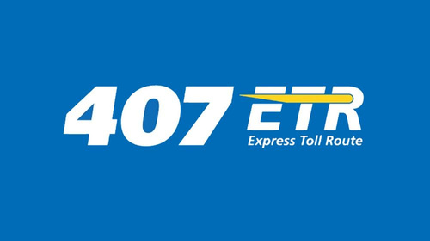

Paperless Opt-in & Opt-out Analysis
Presented by Adaeze Eze

Slide 2

Introduction to results analysis
Objective: Delve into data analysis of paperless billing opt-in/opt-out trends to inform strategic decision-making.

Slide 3
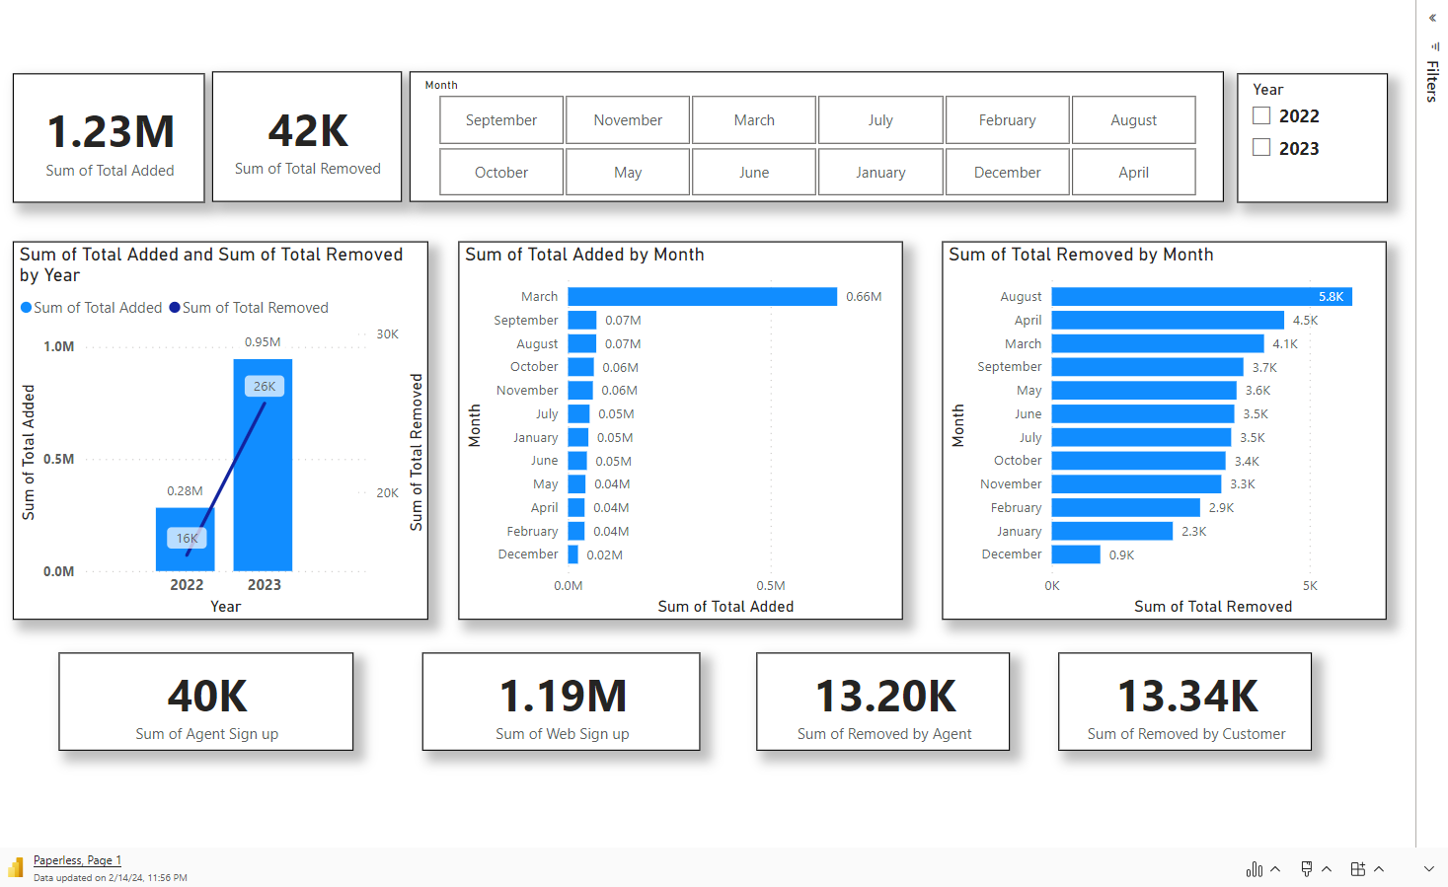

Slide 4
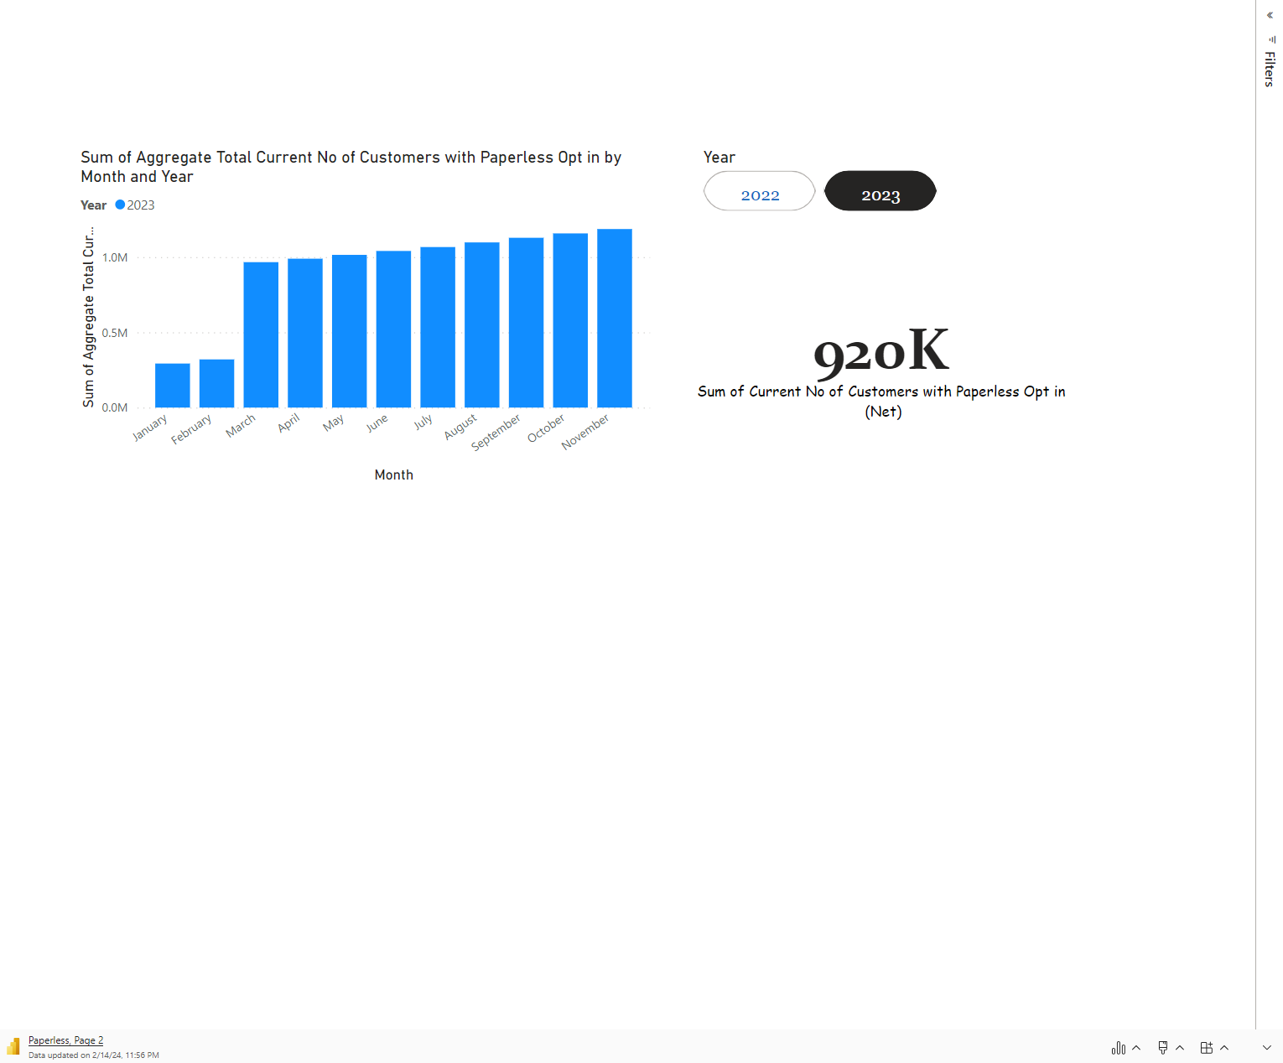

Slide 5
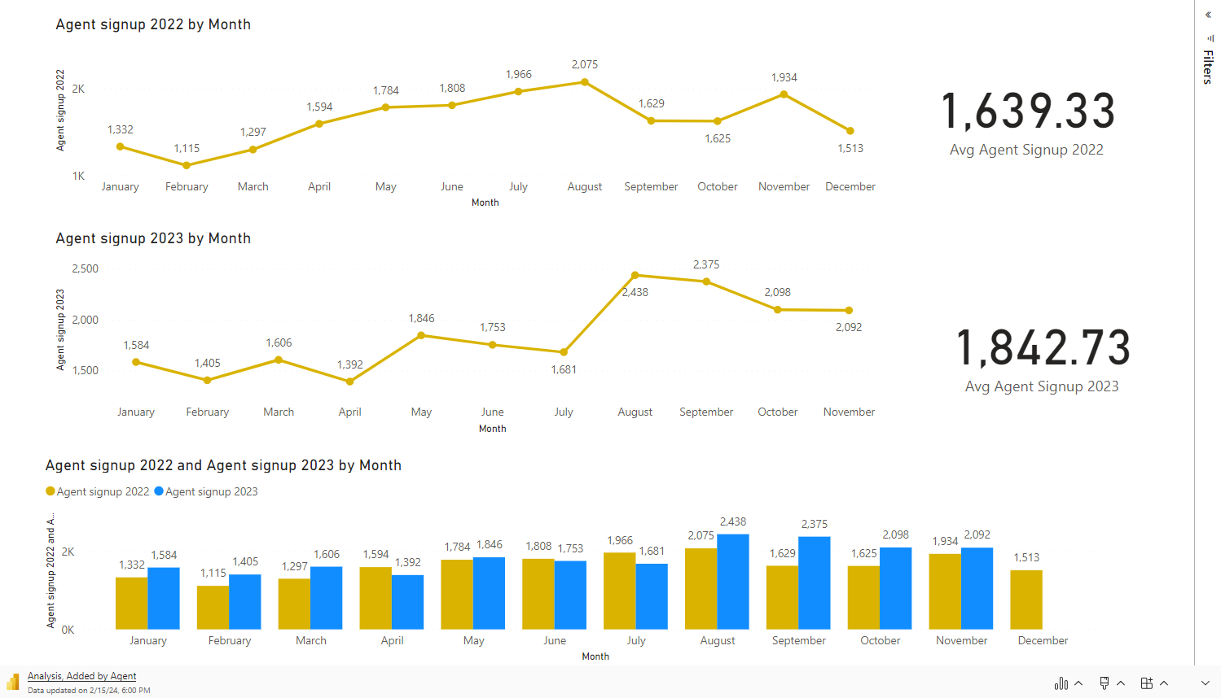

Slide 6
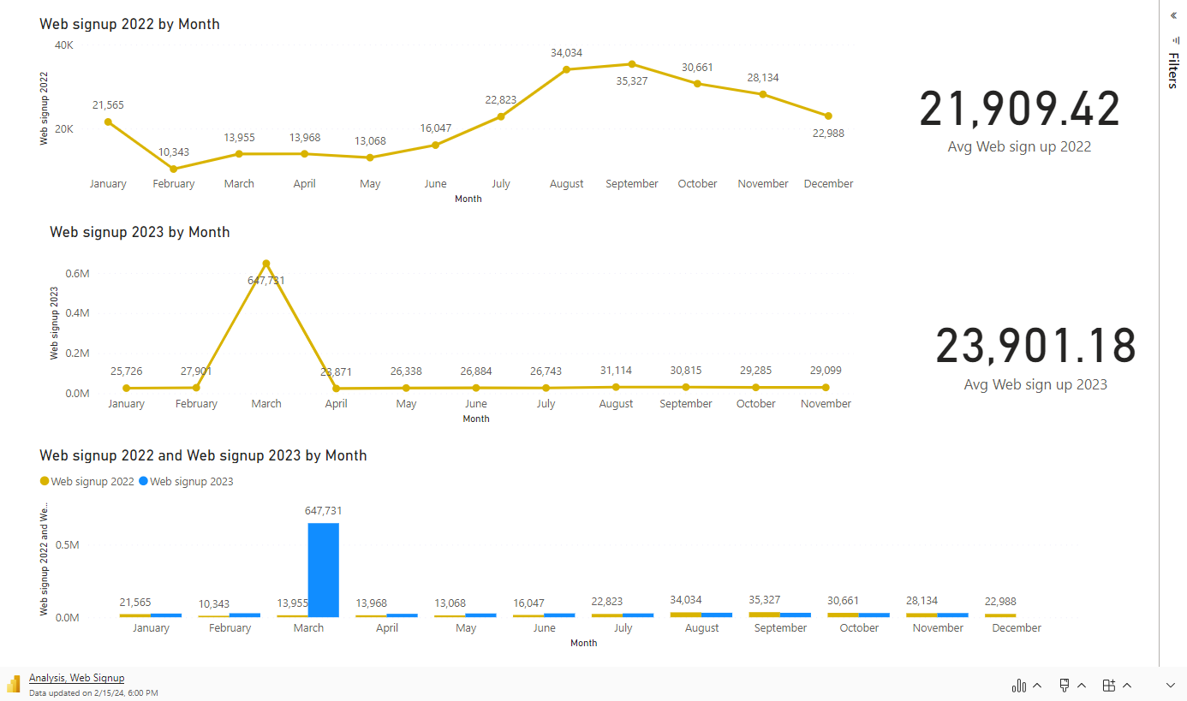

Slide 7
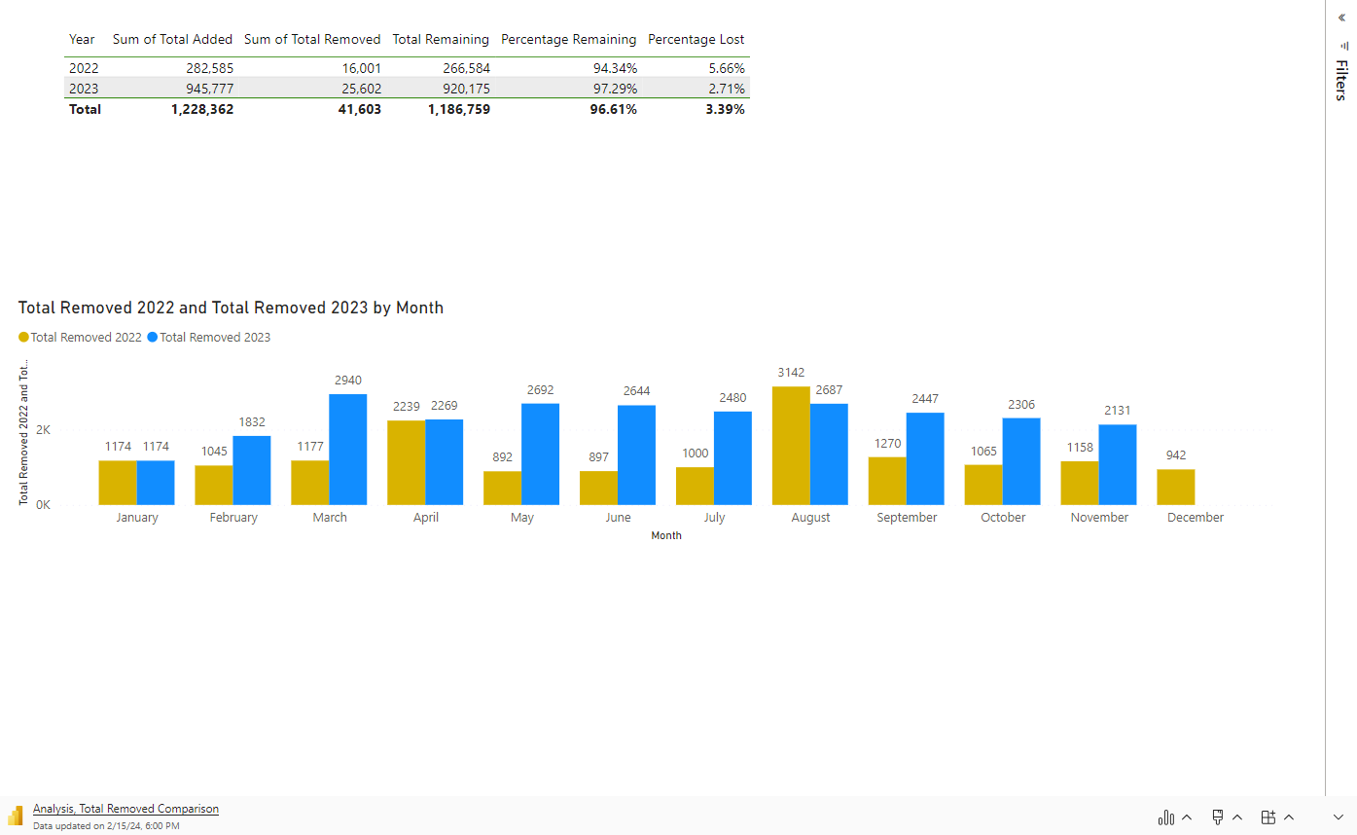

Slide 8
Insights
29%
Upward Trend of Paperless Opt-In
Overall, the data shows a consistent and positive trend in paperless opt-ins, with an average monthly increase of approximately 29.39% over the two-year period.
This upward trajectory suggests a notable and sustained acceptance of digital services& features among customers.

Slide 9
Seasonal Variation Insights
Seasonal Fluctuations
Spike
Fall
Across the year, there are fluctuations in the number of paperless opt-ins, indicating seasonal trends. Months like August, September, and October consistently show higher levels of activity, possibly due to seasonal promotions or specific events encouraging customers to opt for paperless transactions.
A notable spike occurs in March of the second year, with a remarkable surge in paperless opt-ins, reaching 649,337. This extraordinary increase suggests the impact of a significant promotional campaign, new incentives, or system enhancements introduced during that period.
Following the peak in March, there's a subsequent decline in opt-ins, particularly noticeable in April and May. While the numbers remain elevated compared to initial months, they decrease from the peak, indicating a natural regression after the surge in enrollments.

Slide 10

Deep Dive into Data & Problems
Insufficient Data: The provided data is incomplete as it does not include details regarding the mediums of total removed allocation. Additionally, it lacks a comprehensive exploration of customer demographics such as age, location, and type of vehicle owned. Understanding these demographic factors would provide valuable insights into customer decision-making processes, enabling a more thorough analysis of the data and facilitating informed decision-making.
Web Sign Up Process: The current placement of the Paperless billing opt-in process on the 407 website is suboptimal, making it challenging for users to locate. The absence of a clear guide on how to opt in further compounds the issue, particularly for older customers, resulting in low platform usability and accessibility.
Agent Conversion Rate and Pitch Strategy: While agent sign-ups constitute a smaller portion of opt-in acquisitions, they nonetheless hold considerable significance. However, the absence of comparative data between agent sign-ups and the volume of calls or inquiries via chat hinders a comprehensive assessment. Enhancing the overall impact of agent sign-ups remains an opportunity for improvement.
Customer Preference: Exploring customer preferences requires a thorough examination of our company's record-keeping methods. Conducting surveys to capture customer concerns—such as security, privacy, accessibility, language barriers, notification preferences, and resistance to change—would provide valuable insights into why customers opt out. These insights can inform the development of tailored solutions to address specific challenges effectively.

Slide 11

Strategic Plan
The +1 Advice Initiative | Digital How-To Hub: 407 101 | Educational Campaign & Seasonal Based Promotion | Omnichannel Approach
In our ongoing commitment to delivering exceptional customer service, we are introducing the +1 Advice Initiative. This strategic approach empowers our agents to proactively offer valuable advice to customers, enhancing their experience and promoting best practices, particularly the adoption of paperless solutions. | The analysis reveals that most opt-ins originate from web sign-ups, underscoring the critical need to refine and enhance the online opt-in process for our customers. Our objective is to create an Elevated Online Experience by optimizing the web sign-up journey, making it more intuitive and user-friendly. | Utilize customer data for personalized communication promoting paperless billing benefits and addressing concerns. Integrate educational content into seasonal promotions to boost engagement and encourage opt-ins. | Utilize an omnichannel approach for paperless billing, offering customers communication options via email, SMS, or in-app messages alongside the "My Account" portal. Implement email billing securely as PDF attachments, maximizing convenience and accessibility for customers while promoting adoption of paperless billing at 407 ETR.
Scan, Connect, Resolve, Provide | Intuitive Design Enhancements Guided Video Resources | Implement targeted messaging campaigns to directly address common concerns or objections regarding paperless options, offering solutions and reassurance to alleviate apprehensions. | Provide our customers with multiple communication channels for paperless billing notifications.
BCK TO AGENDA PAGE

Slide 12
Measurements
Metrics | KPIs | Expectations
Number of proactive advice interactions initiated by agents. User engagement metrics on the How-To Hub platform (e.g., video views, time spent). Engagement metrics on educational content (e.g., views, shares). Customer feedback ratings on the helpfulness of advice provided. Opt-in rates across different communication channels (e.g., email, SMS, in-app messages). Open rates, click-through rates, and conversion rates of targeted messages. | Increase in paperless opt-ins following advice interactions. Improvement in customer satisfaction scores related to agent interactions. Reduction in customer support inquiries related to the opt-in process. Percentage increase in paperless opt-ins during promotional periods. Percentage of customers opting in through each channel compared to total opt-ins. Percentage increase in paperless opt-ins following targeted messaging campaigns. Reduction in customer objections or concerns related to paperless options. | Expect to see an increase in paperless opt-ins as customers are guided towards the benefits of digital solutions. Expect higher opt-in rates through the digital platform due to improved user experience and accessibility. Expect to see spikes in paperless opt-ins during promotional campaigns, driven by increased awareness and incentives. Expect a diversification of opt-in channels, catering to various customer preferences and increasing overall opt-in rates. Expect higher opt-in rates driven by targeted messaging addressing customer concerns and objections.

Slide 13
Implementation Roadmap
Iterate and Improve
Deploy Campaigns
Measure Impact
Identify Key Metrics & Customer Segments
Cross-Functional Collaboration & Value Stream Mapping
Lean Testing & Gemba Walks
Identify Objectives
Data Collection and Analysis
Iterative Improvement Cycle

Slide 14






Cross-functional Team Kanban Board
Product Team
Customer Service/Support:
Customer Solutions Team
Data Team
Marketing and Communications:
User Experience UX

Slide 15
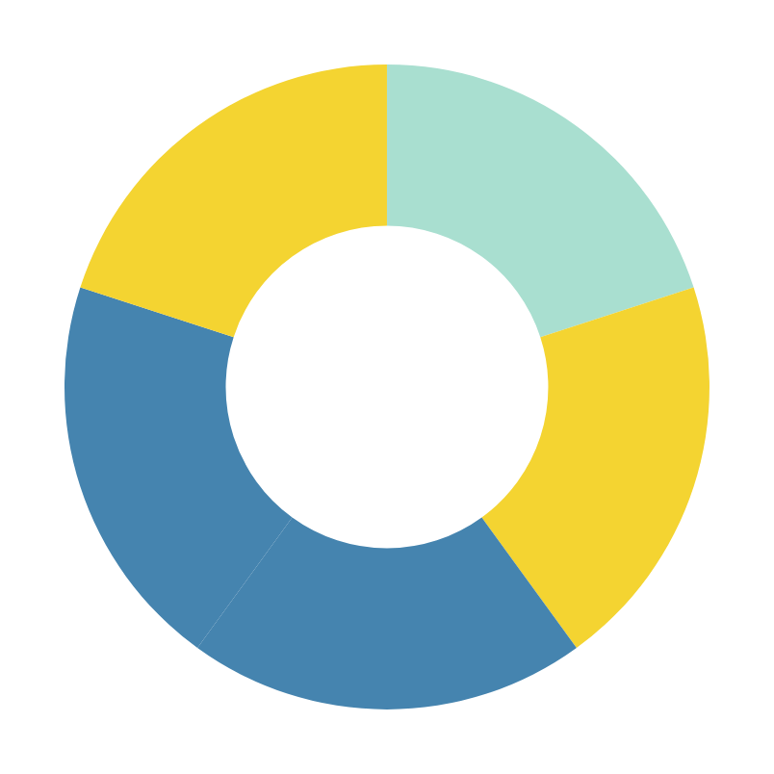
Questions?
Tools used: Power BI, Excel, PowerPoint

Slide 16
Presented by Adaeze Eze
Thank you very much!

